Slide 1
PA2: Structure-from-Motion (SfM)
2018. 10. 25
Sunghoon Im

Slide 2
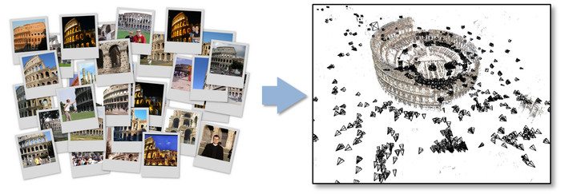
What is SfM?
SfM (Structure from Motion)
The process of estimating three-dimensional structures from two-dimensional image sequences which may be coupled with local motion signals.
Input: Freely taken images with overlapped scenery
Output: Camera pose and 3D structure of the scene
[1] Agarwal, Sameer, et al. "Building Rome in a day." 2009 IEEE 12th international conference on computer vision. IEEE, 2009.

Slide 3
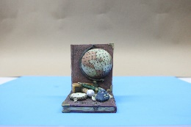
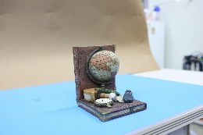
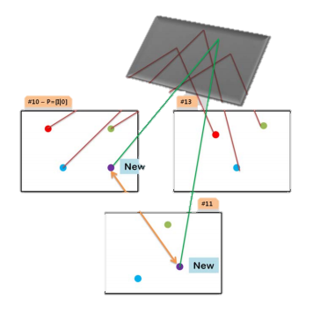
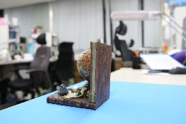
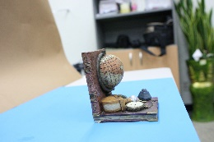

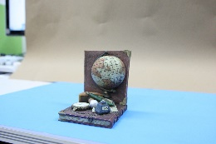
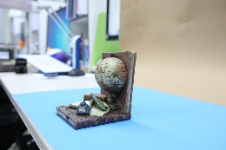
Overall Strategy
A set of images
Feature Extraction
& Matching
(Two-view)
Initialization Step
( > Three-view)
Growing Step
[4] Hartley, Richard, and Andrew Zisserman. Multiple view geometry in computer vision. Cambridge university press, 2003.
[5] Szeliski, Richard. Computer vision: algorithms and applications. Springer Science & Business Media, 2010.

Slide 4
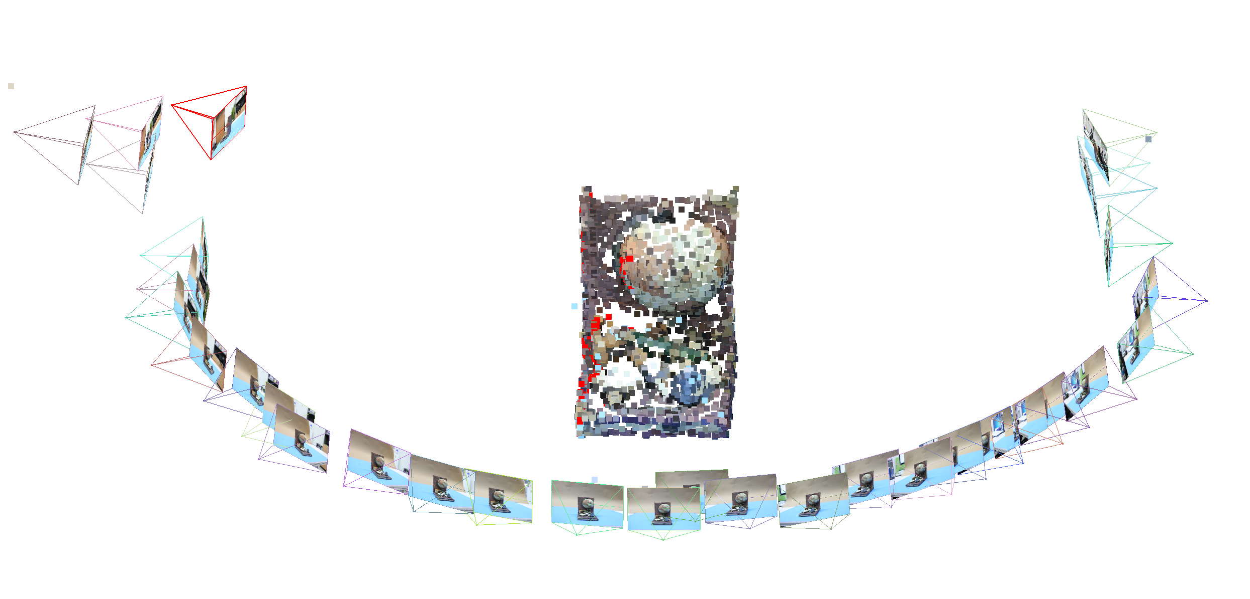
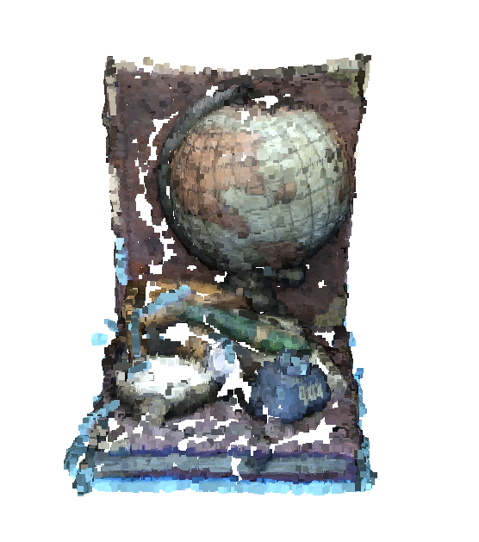
PA2: Structure from Motion
Goal: Build a 3D & Estimate camera poses, given the set of images

Slide 5
Objective of PA2 (SfM)
Practice and Understand:
Camera Calibration
Automatic Correspondence Search with handling outliers
Epipolar Geometry & Perspective-n-Point problem
Optimization (Bundle Adjustment)

Slide 6
1. Camera Calibration

Slide 7
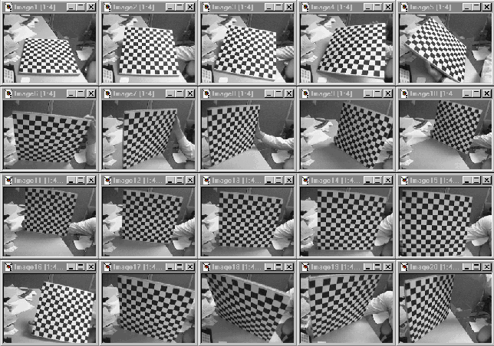
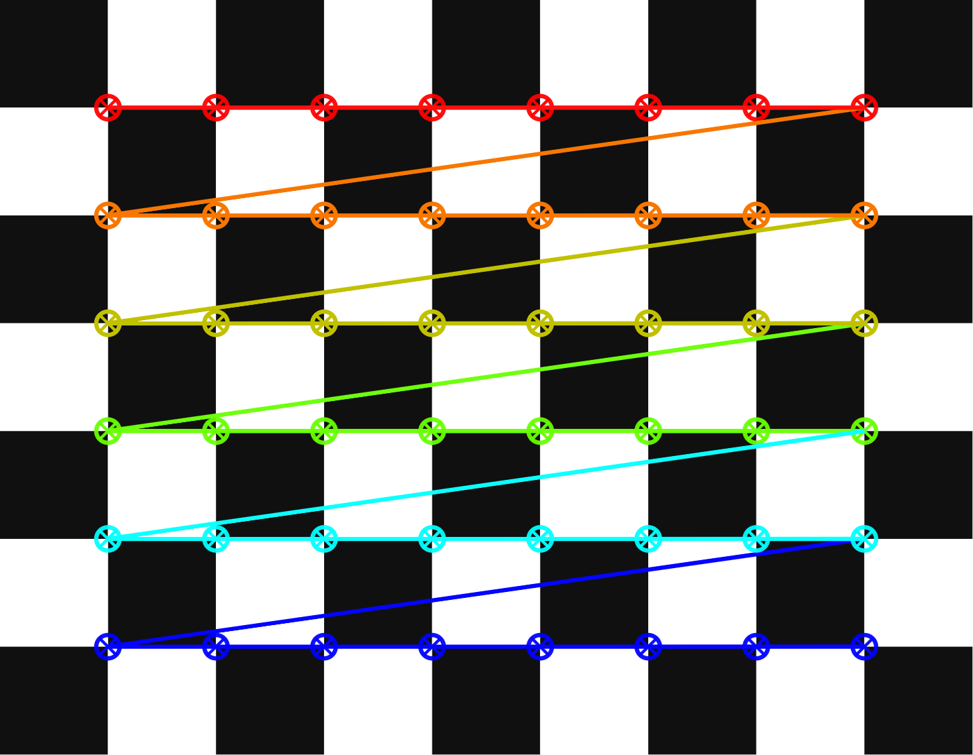
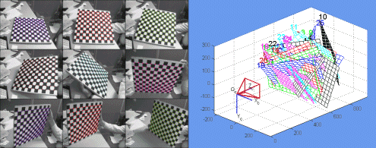
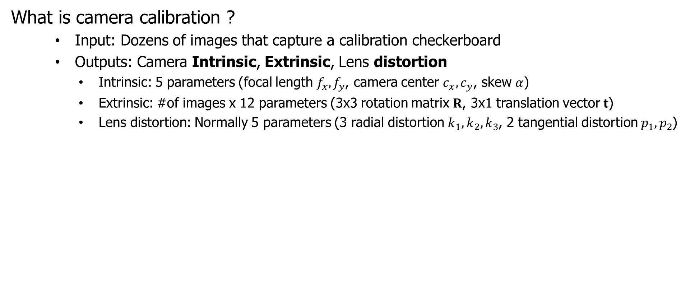
1. Camera Calibration
What is camera calibration ?
Input: Dozens of images that capture a calibration checkerboard
Outputs: Camera Intrinsic, Extrinsic, Lens distortion
Intrinsic: 5 parameters (focal length $f_{x},f_{y}$, camera center $c_{x},c_{y}$, skew $α$)
Extrinsic: #of images x 12 parameters (3x3 rotation matrix $R$, 3x1 translation vector $t$)
Lens distortion: Normally 5 parameters (3 radial distortion $k_{1},k_{2},k_{3}$, 2 tangential distortion $p_{1},p_{2}$)
(1) Capture multiple images of checkerboard
(2) Detect corners
(3) Zhang’s Calibration
Zhang’s method requires (a) The coordinates of corners (b) Image size

Slide 8
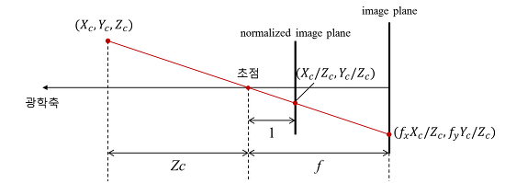
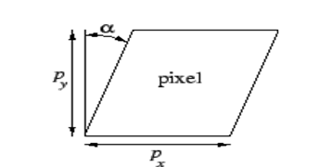

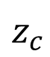


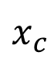
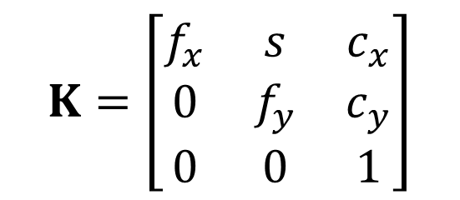
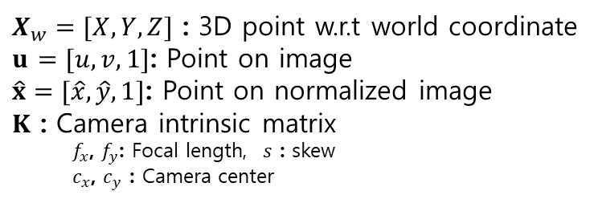


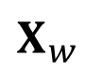
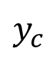


1. Camera Calibration
Perspective projection
(Pinhole model)
Camera intrinsic parameters
$$X_{w}$$
영상 좌표계
Image coordinate
$$u$$
Skew
$$v$$
$$u$$
$X_{w}=[X,Y,Z]$ : 3D point w.r.t world coordinate
$u$ $=[u,v,1]$: Point on image
$\hat{x}=[\hat{x},\hat{y},1]$: Point on normalized image
$K$ : Camera intrinsic matrix
$f_{x}$, $f_{y}$: Focal length, $s$ : skew
$c_{x}$, $c_{y}$ : Camera center
$$x$$
정규 영상 좌표계
Normalized image coordinate
$$\hat{x}$$
$$\hat{x}$$
$$\hat{y}$$
$$K=\left[\begin{matrix}f_{x} & s & c_{x} \\ 0 & f_{y} & c_{y} \\ 0 & 0 & 1\end{matrix}\right]$$
$$z_{c}$$
카메라 좌표계
Camera coordinate
$$x_{c}$$
$$y_{c}$$

Slide 9
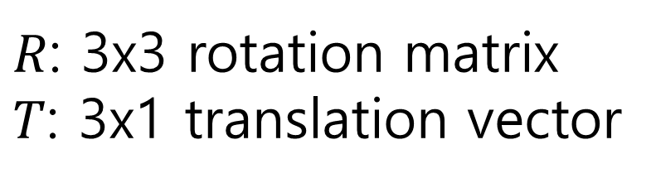

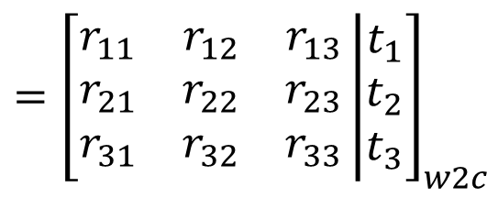
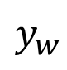
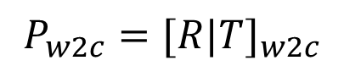
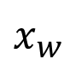
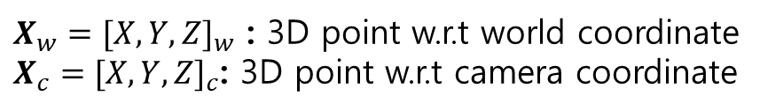

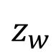

1. Camera Calibration
$R$: 3x3 rotation matrix
$T$: 3x1 translation vector
Camera Extrinsic Parameters
$$X_{w}$$
$$P_{w2c}={[R|T]}_{w2c}$$
$${=\left[\begin{matrix}r_{11} & r_{12} & r_{13} \\ r_{21} & r_{22} & r_{23} \\ r_{31} & r_{32} & r_{33}\end{matrix}\left|\begin{matrix}t_{1} \\ t_{2} \\ t_{3}\end{matrix}\right.\right]}_{w2c}$$
$$X_{c}=P_{w2c}X_{w}$$
$X_{w}={[X,Y,Z]}_{w}$ : 3D point w.r.t world coordinate
$X_{c}={[X,Y,Z]}_{c}$: 3D point w.r.t camera coordinate
$$z_{c}$$
카메라 좌표계
Camera coordinate
$$y_{w}$$
$$x_{c}$$
$$P_{w2c}$$
표준 좌표계
World coordinate
$$y_{c}$$
$$z_{w}$$
$$x_{w}$$

Slide 10
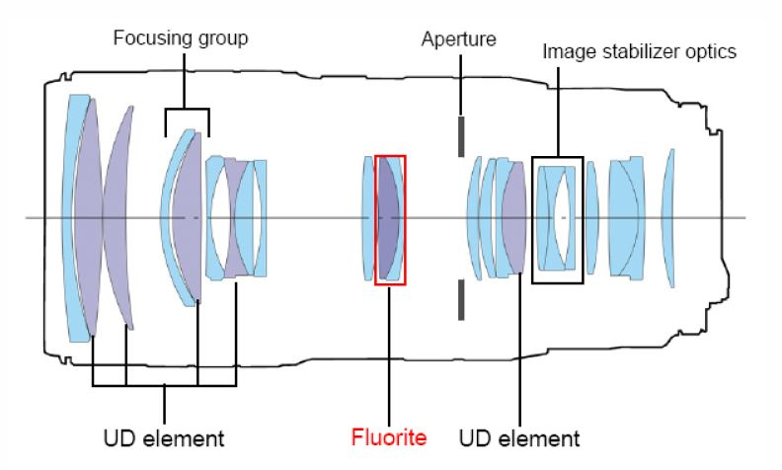
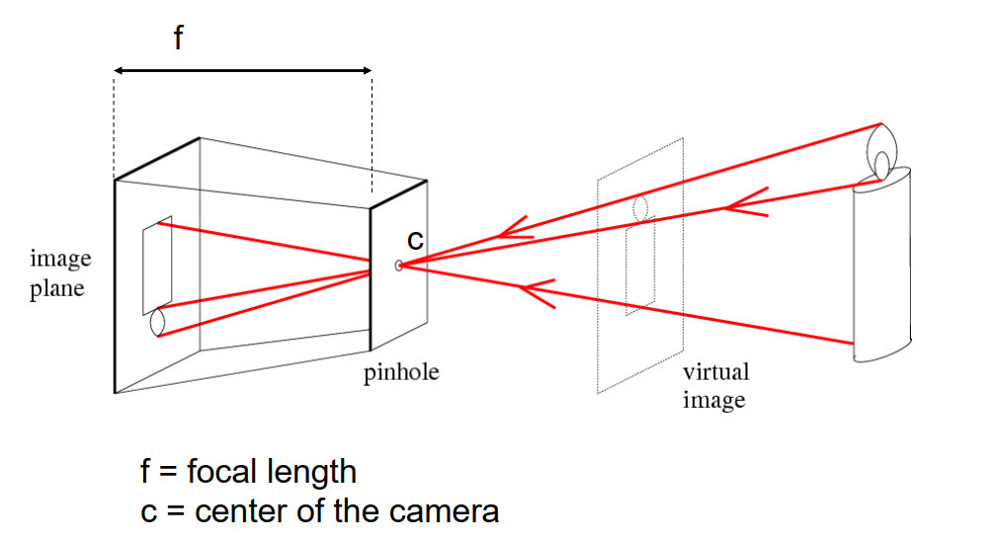
1. Camera Calibration
Pinhole camera model
(Brunelleschi at 15th century)
David A. Forsyth and Jean Ponce (2003). Computer Vision, A Modern Approach. Prentice Hall. ISBN 0-12-379777-2.

Slide 11
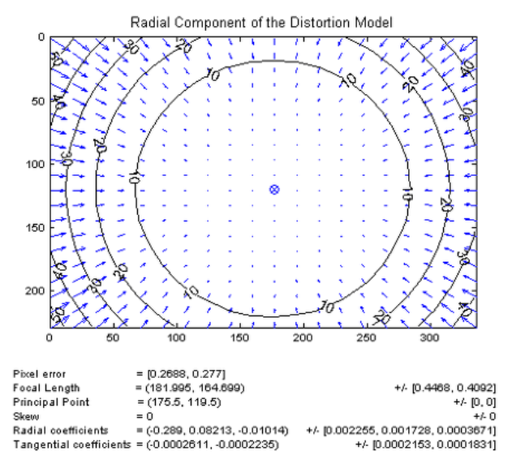
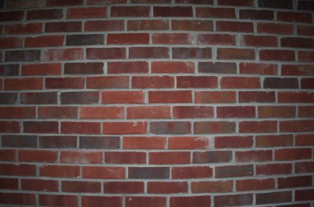
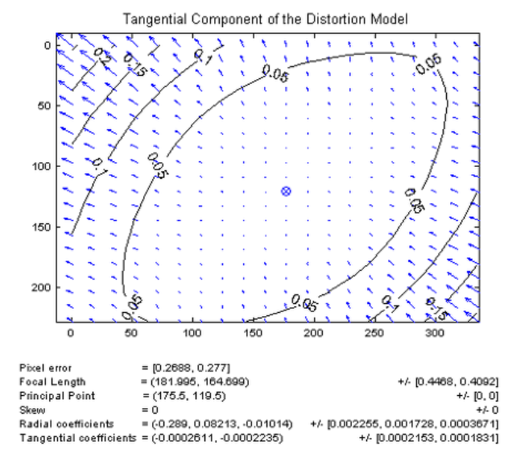
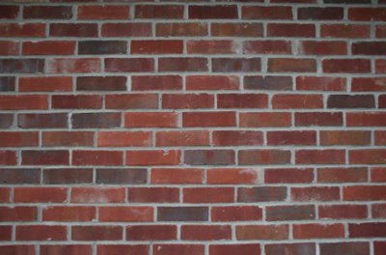
1. Camera Calibration
Radial
Lens Distortion Parameters
Undistorted to distorted coordinate
5 parameters (MATLAB toolbox & OpenCV)
Radial
Tangential
http://www.vision.caltech.edu/bouguetj/calib_doc/index.html
Tangential
Distorted image
Radial distortion:
This is due to the refractive index of the convex lens, and the distortion of the image is determined by the distance from the center.
Tangential distortion:
Distortion caused by camera lens (CCD, CMOS) is not aligned horizontally or centering of lens itself is not made during camera manufacturing (assembly) process.
Un-distorted image

Slide 12

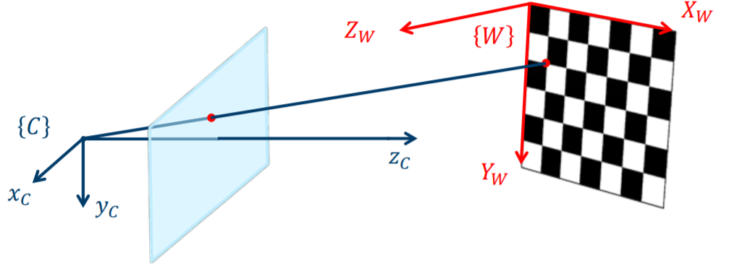
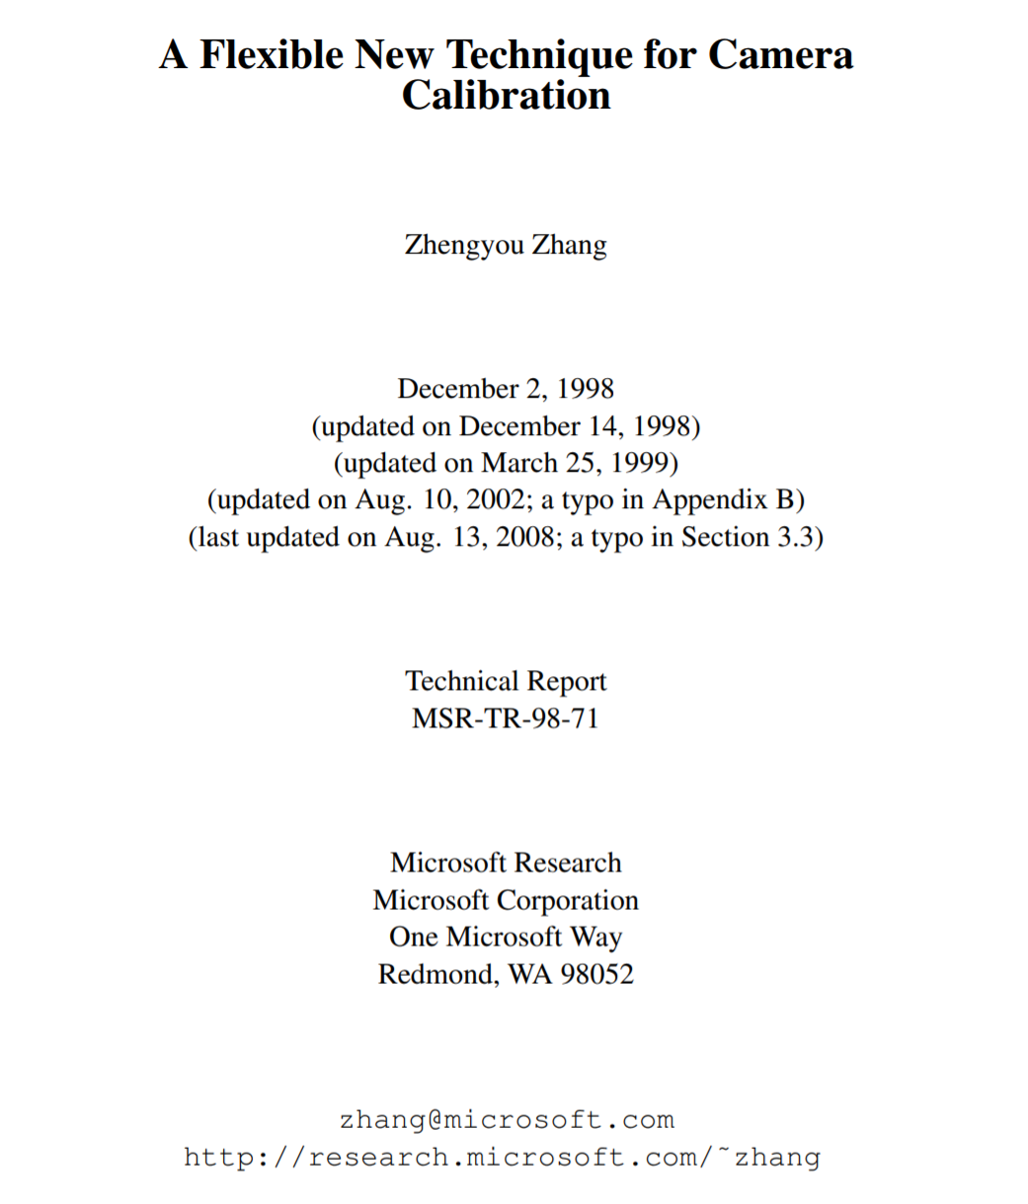
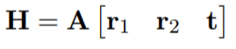
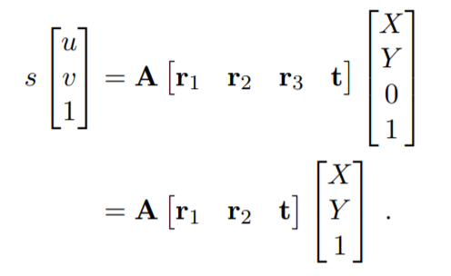
1. Camera Calibration
Zhang’s Calibration idea
Zhang’s method requires that the calibration object is planar
Then the 3D-2D relationship is described by a homography
Without loss of generality, we assume the model plane is on Z = 0 of the world coordinate system.

Slide 13
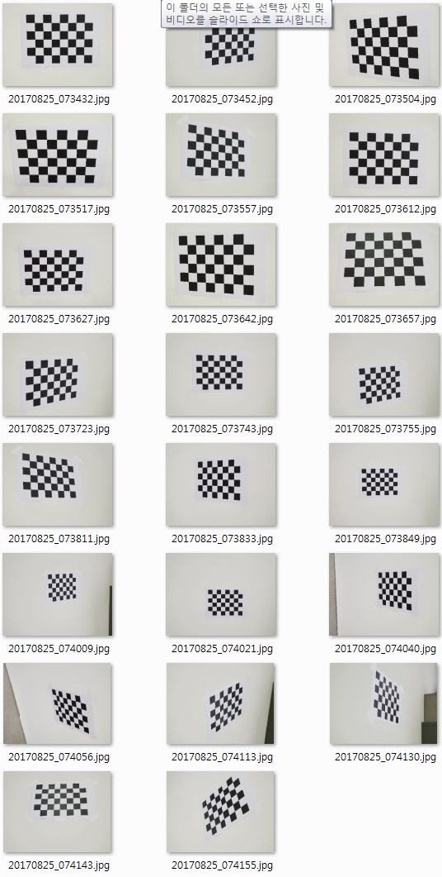
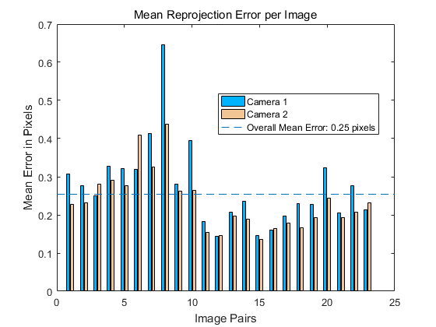
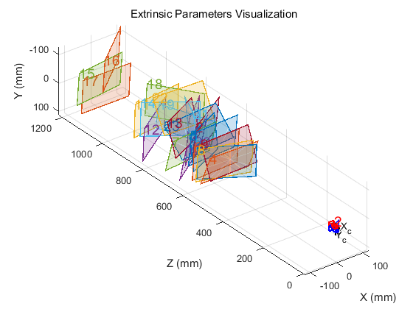
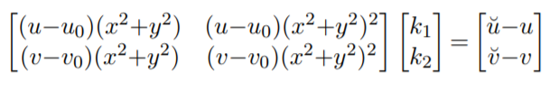
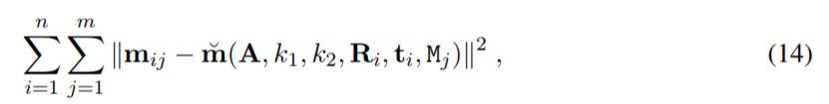
1. Camera Calibration
https://www.microsoft.com/en-us/research/wp-content/uploads/2016/02/tr98-71.pdf
Zhang’s Calibration in short
Print a pattern and attach it to a planar surface
Take a few images of the model plane under different orientations by moving either the plane or the camera
Detect the feature points in the images
Estimate the five intrinsic parameters and all the extrinsic parameters using the closed-form solution as described in Sect. 3.1
Estimate the coefficients of the radial distortion by solving the linear least-squares (13)
Refine all parameters by minimizing (14).
Camera Calibration using Tool Box
MATLAB Library: http://www.vision.caltech.edu/bouguetj/calib_doc/index.html
C Library: http://docs.opencv.org/doc/tutorials/calib3d/camera_calibration/camera_calibration.html

Slide 14
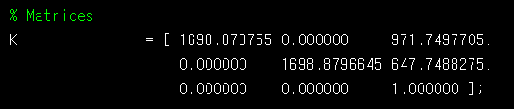
1. Camera Calibration
We provide camera intrinsic for provided dataset
You should calibrate the camera when you do SfM with own dataset
Tips for making your own dataset
1) Use a fixed-focus camera.
2) Do calibration for camera parameter estimation using toolbox (to get intrinsic).
3) Take pictures of your target scene with the camera of which the intrinsic parameter is known now.
4) Run your SfM program with your dataset by replacing the images and the camera intrinsic matrix K to yours.
5) Explain the way how you do it and show the results on the report.

Slide 15
2. Correspondence Search

Slide 16

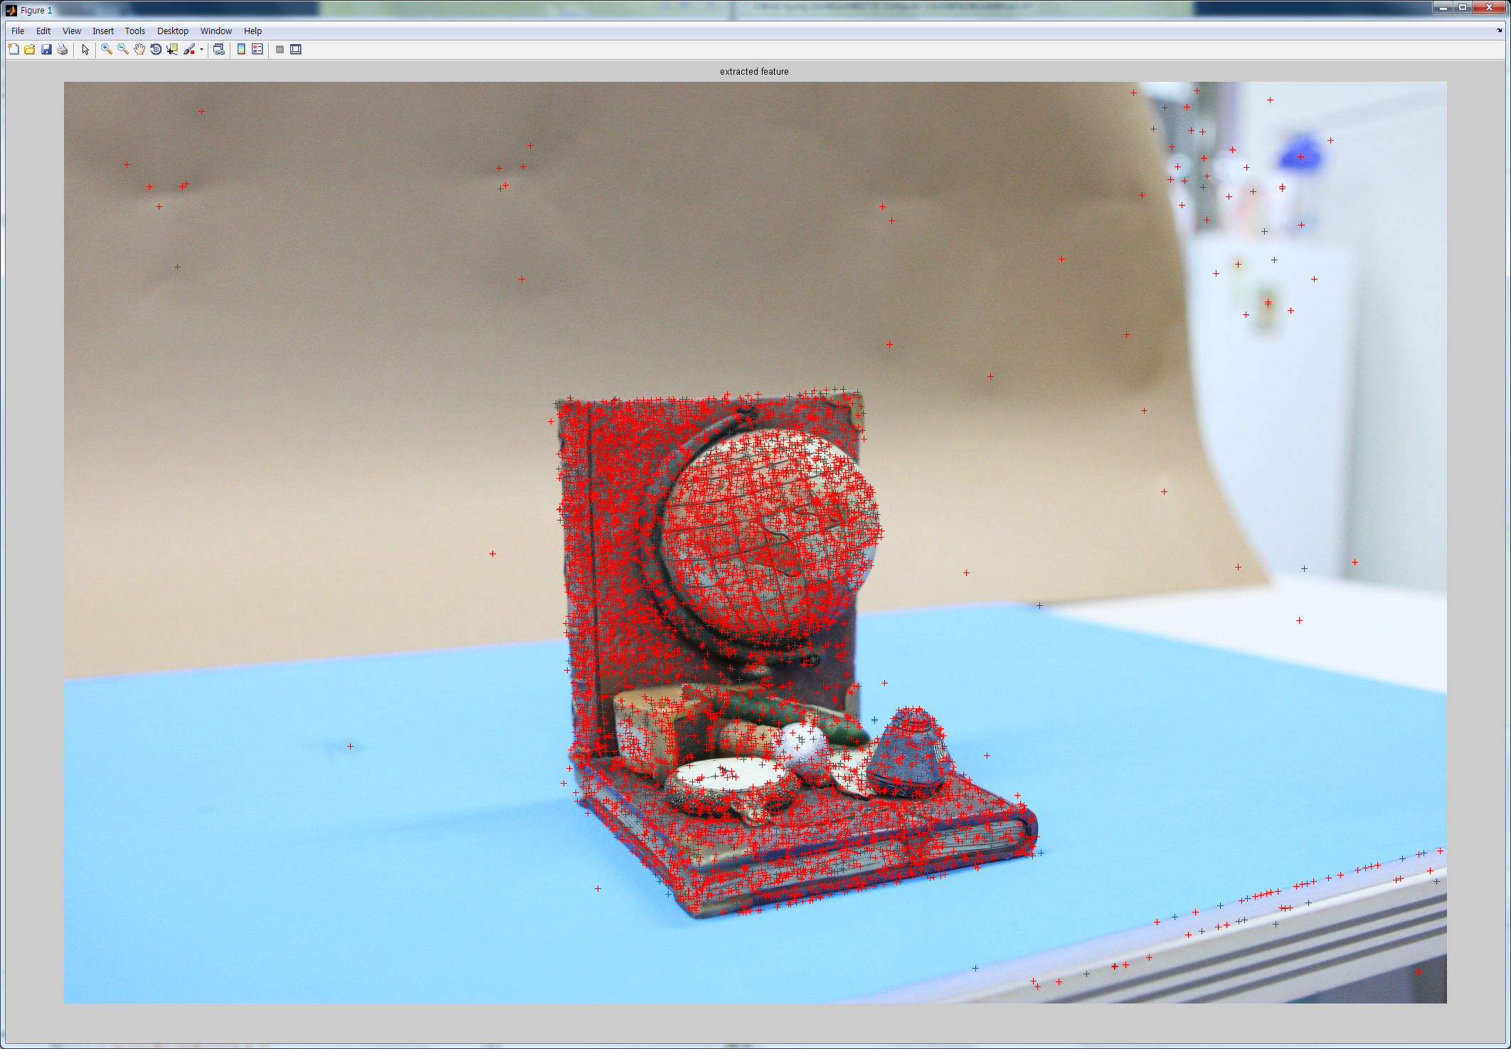
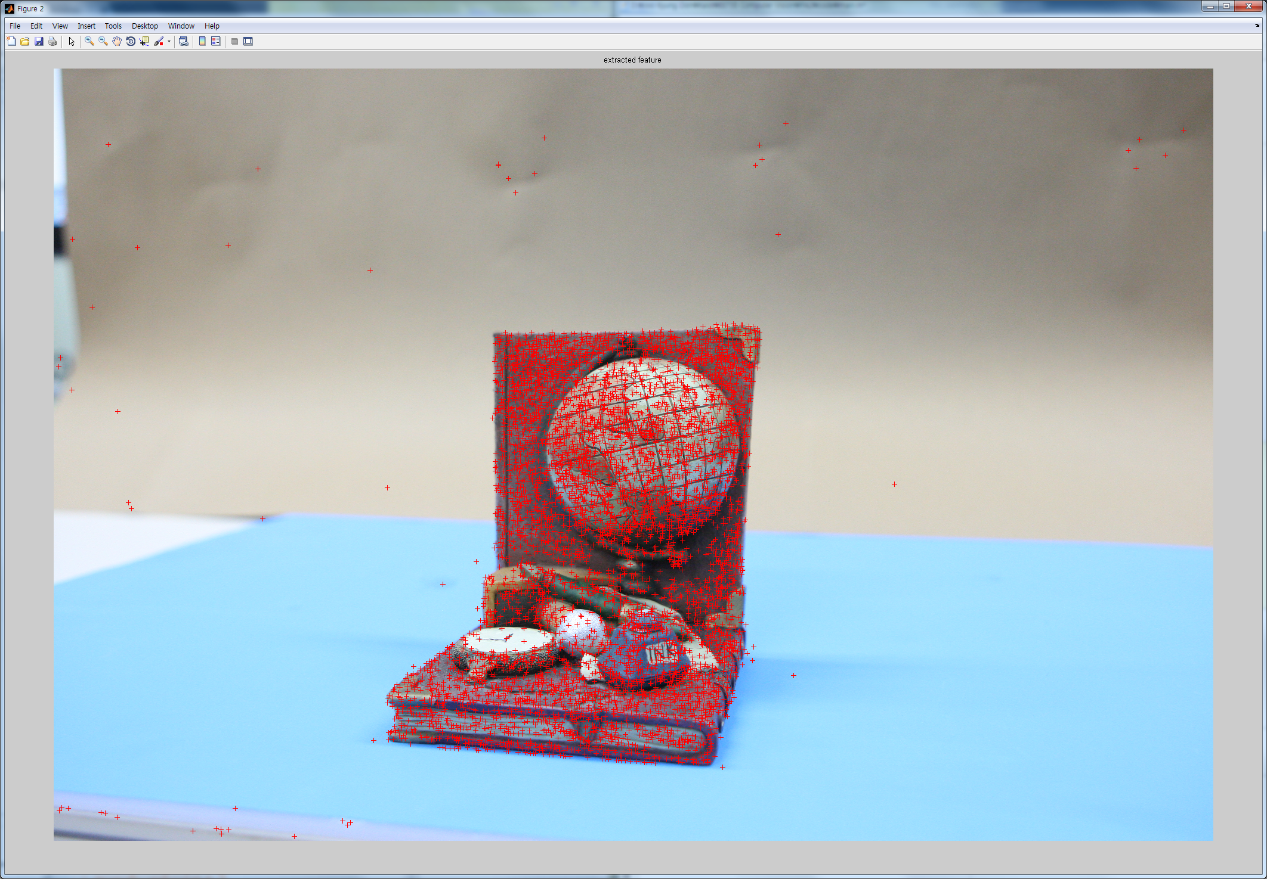
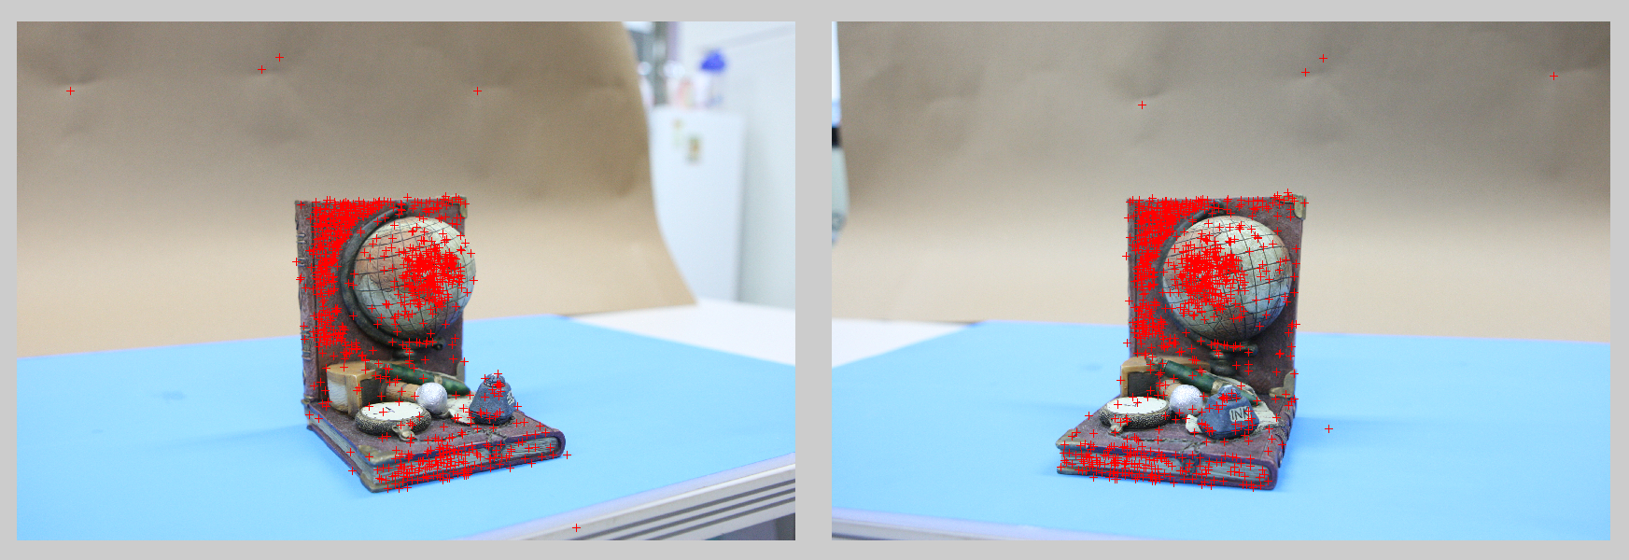
2. Correspondence Search
Objective
Understand the meaning of feature and descriptor
Understand the key roles of correspondence in Structure-from-Motion
Handle the big data structure about the feature and descriptor.
Example of SIFT (feature extractor, descriptor)
Feature Matching
Feature Extraction
15
14
A set of images
Feature Extraction
& Matching
Initialization Step
Growing Step

Slide 17
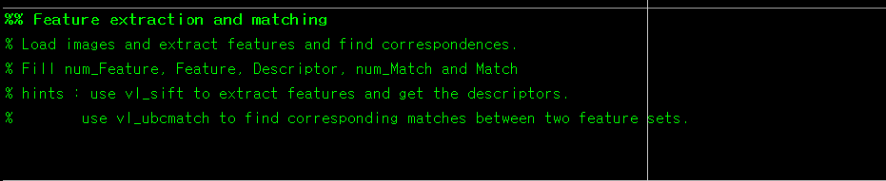
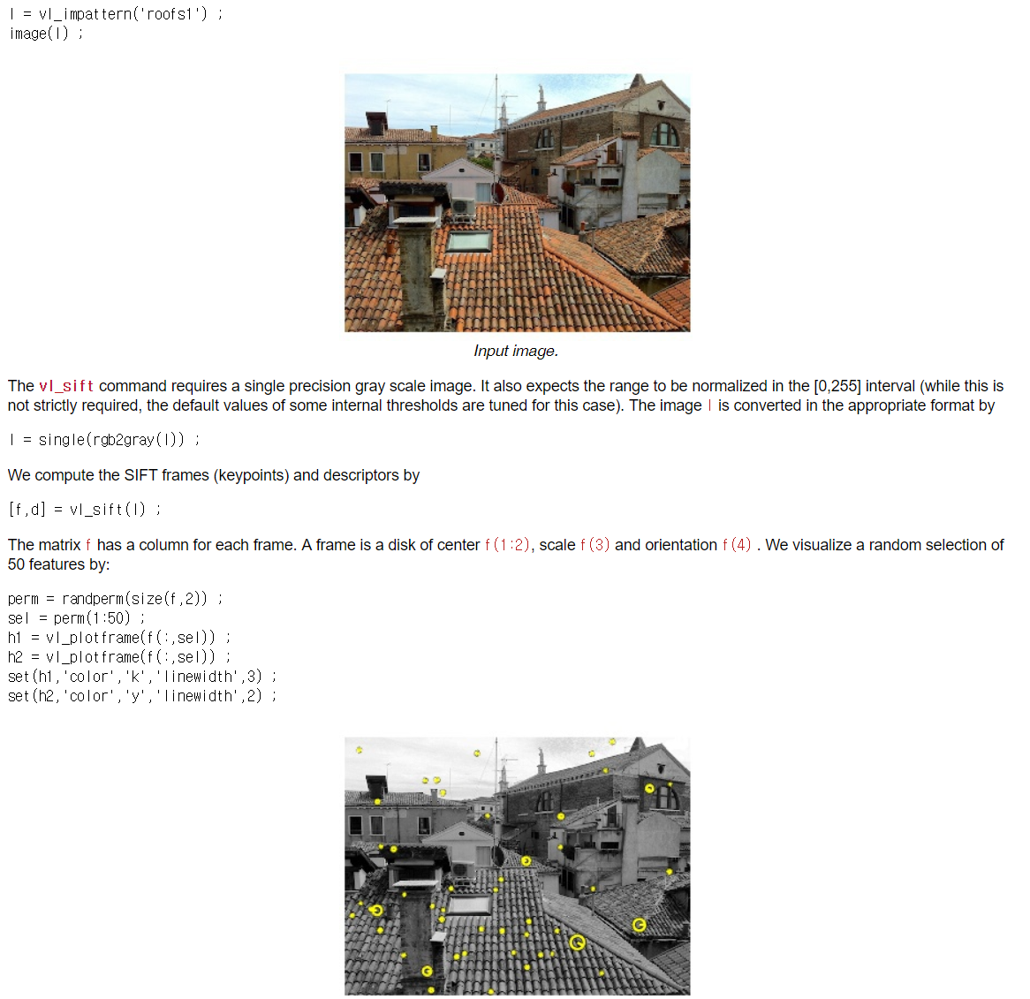

2. Correspondence Search
Code you should fulfill
SIFT (Scale Invariant Feature Transform)
http://www.vlfeat.org/overview/sift.html

Slide 18

2. Correspondence Search
Match #of images x max #of features x #of images
num_Feature, num_Match : calculate the number of features and matches
In Skeleton code
Features 4 x #of features x #of images (4: Disk of center (x,y), scale, orientation)
Descriptor 128 x #of features x #of images (128 length descriptor)
Matrix (data structure) you should fulfill

Slide 19




2. Correspondence Search
In Skeleton code
Find best matches using num_Feature
$j^{th}$ image
Ex)
Maximum matching points pair
$i^{th}$ image
Reference
: 4th image
Pair
: 3rd image

Slide 20
3. Epipolar Geometry & PnP problem

Slide 21

3. Epipolar Geometry & PnP problem
Objective
Epipolar geometry:
The geometric relation between two views
Use 5pt, 7pt, 8pt algorithms for Fundamental ($F$) or Essential ($E$) matrix
Perspective-n-Point (PnP) problem
The problem of estimating the pose of a calibrated camera given a set of n 3D points in the world and their corresponding 2D projections in the image.
When n = 3, PnP problem is in its minimal form of P3P and can be solved with three point correspondences.
Additionally
Correspondences are required
RANSAC can be used to deal with outliers in the data set

Slide 22

3. Epipolar Geometry & PnP problem
Epipolar Geometry
Image 1
Image 2
epipolar plane
epipolar line for
epipolar line for
camera1
center
camera2
center
Epipolar Lines
: camera centers,
: (camera) baseline
: epipolar plane,
: epipoles
Fundamental matrix
: epipolar lines for and respectively
where,
: point on image plane
[4] Hartley, Richard, and Andrew Zisserman. Multiple view geometry in computer vision. Cambridge university press, 2003.

Slide 23

3. Epipolar Geometry & PnP problem
Algorithm for Fundamental ($F$) or Essential ($E$) matrix
Un-calibrated (Unknown camera intrinsic $K$)
Normalized 8-pts algorithm
7-pts algorithm
Calibrated (Known camera intrinsic $K$)
Estimate $E$ using 5-pts algorithm [7]
Calculate $F$
Essential matrix: The specialization of the fundamental matrix to the case of normalized image coordinates
where,
where,
[7] Nistér, David. "An efficient solution to the five-point relative pose problem.“ TPAMI 2004

Slide 24







3. Epipolar Geometry & PnP problem
[8] Haralick, Bert M., et al. "Review and analysis of solutions of the three point perspective pose estimation problem." IJCV (1994)
Perspective-3-Point algorithm (P3P)
$${s_{2}}^{2}+{s_{3}}^{2}−2s_{2}s_{3}cosα=a^{2}$$
$${s_{1}}^{2}+{s_{3}}^{2}−2s_{1}s_{3}cosβ=b^{2}$$
$${s_{1}}^{2}+{s_{2}}^{2}−2s_{1}s_{2}cosγ=c^{2}$$
$j_{i}$: Unit vector
$s_{i}$=$\left\|P_{i}\right\|$,
$$P_{i}=s_{i}j_{i}, (i=1,2,3)$$
$W$ith the $P_{i}$, camera pose is linearly solved

Slide 25

3. Epipolar Geometry & PnP problem
Initial step:
What should we use (Epipolar geometry or PnP algorithm)?
Epipolar geometry !!
We do not have the 3D points. (PnP algorithms needs 3D-2D correspondences)
Estimate Essential matrix $E$ using 5-pt algorithm, then decompose $E$ into camera poses
Estimate Essential matrix ‘E’ given a set of match points {x, x’}
Use the functions ‘calibrated_fivepoint’
Website : http://vis.uky.edu/~stewe/FIVEPOINT/
A set of images
Feature Extraction
& Matching
Initialization Step
Growing Step
Find the best image pair
8, 7-pt algorithm (F)
Triangulation
Calibrated, 5-pt algorithm (E)

Slide 26




3. Epipolar Geometry & PnP problem
MVG 9.6 (p.257-p.260)
6.2.3 (p.162)
Essential Matrix Decomposition to [R|T]
Camera matrix to essential matrix
Essential matrix to camera matrix
Make your own code
$$E=[t]_{×}R=R[R^{T}t]$$
$R,t$: Rotation, Translation
$SVD\left(E\right)=Udiag\left(1,1,0\right)V^{T}$
$W=\left[\begin{matrix}0 & −1 & 0 \\ 1 & 0 & 0 \\ 0 & 0 & 0\end{matrix}\right]$
$u_{3}=U{(0,0,1)}^{T}$: The last column vector of U

Slide 27


3. Epipolar Geometry & PnP problem
Essential Matrix Decomposition to [R|T]
There are four possible reconstruction
Depth for both camera should be positive value (case 1)
Not negative value (case 2, 3, 4)
You should figure out the optimal camera pose

Slide 28

3. Epipolar Geometry & PnP problem
2 points
5-pts algorithms with RANSAC
threshold
1. Randomly select sets of 5 points
2. Generate E(hypothesis) and evaluate using other points with pre-defined threshold - epipolar distance (see next page)
3. Do this for many times and choose the most supportive hypothesis having the most inliers
3 points
6 points
2 points
Randomly Selected correspondence
$$\{x_{c1}, …,x_{c5}\}$$
$$\{{x′}_{c1}, …,{x′}_{c5}\}$$
E using calibrated
5-pt algorithm

Slide 29


3. Epipolar Geometry & PnP problem
5-pts algorithms with RANSAC
Compute the number of inliers
Choose the best E with the largest number of inliers

Slide 30











3. Epipolar Geometry & PnP problem
$X$ : 3D point
$x$ : Point on image coordinate
$K$ : Intrinsic matrix
$P$ ($K[R|t])$: Extrinsic matrix
Triangulation
Get 3D points from Camera pose & correspondences
$$X_{2}$$
$$X_{1}$$
$$X_{3}$$
$${x′}_{2}$$
$$x_{2}$$
$${x′}_{1}$$
$${x′}_{3}$$
$$x_{1}$$
$$x_{3}$$
Cam2
Cam1
A set of images
Feature Extraction
& Matching
Initialization Step
Growing Step
Find the best image pair
8, 7-pt algorithm (F)
Triangulation
Calibrated, 5-pt algorithm (E)

Slide 31


3. Epipolar Geometry & PnP problem
Growing step:
What should we use (Epipolar geometry or PnP algorithm)?
PnP algorithm !!
We have the 3D points. (It requires less number of correspondences (3 points)
Estimate camera poses $[R|T]$ using P3P algorithm
Estimate Camera matrix ‘P’ given a set of match points and 3D {x, X}
Use the functions ‘PerspectiveThreePoint’
Website : http://vis.uky.edu/~stewe/FIVEPOINT
A set of images
Feature Extraction
& Matching
Initialization Step
Growing Step
Estimate Motion
Find the best image pair
6-pt DLT algorithm
Triangulation
3-pt algorithm

Slide 32

3. Epipolar Geometry & PnP problem
2 points
P3P algorithms with RANSAC
threshold
1. Randomly select sets of 3 points
2. Generate [R|T] (hypothesis) and evaluate using other points with pre-defined threshold - geometric error 3. Do this for many times and choose the most supportive hypothesis having the most inliers
3 points
6 points
2 points
Randomly Selected correspondence
$$\{x_{c1}, …,x_{c3}\}$$
$$\{X_{c1}, …,X_{c3}\}$$
[R|T] using
P3P algorithm

Slide 33




3. Epipolar Geometry & PnP problem
[2] Hartley, Richard, and Andrew Zisserman. Multiple view geometry in computer vision. Cambridge university press, 2003.
P3P algorithms with RANSAC
Compute the number of inliers
Choose the best P with the largest number of inliers

Slide 34
3. Epipolar Geometry & PnP problem
$X$ : 3D point
$x$ : Point on image coordinate
$K$ : Intrinsic matrix
$P$ ($K[R|t])$: Extrinsic matrix
Triangulation
Get 3D points from Camera pose & correspondences
$$X_{2}$$
$$X_{1}$$
$$X_{3}$$
$${x′}_{2}$$
$$x_{2}$$
$${x′}_{1}$$
$${x′}_{3}$$
$$x_{1}$$
$$x_{3}$$
Cam2
Cam1
A set of images
Feature Extraction
& Matching
Initialization Step
Growing Step
Find the best image pair
8, 7-pt algorithm (F)
Triangulation
Calibrated, 5-pt algorithm (E)

Slide 35
4. Optimization (Bundle Adjustment)

Slide 36


Optimization
Bundle adjustment
Refines a visual reconstruction to produce jointly optimal 3D structure and viewing parameters
‘Bundle’ refers to the bundle of light rays leaving each 3D feature and converging on each camera center.
Before Bundle adjustment
After Bundle adjustment
[6] Triggs, Bill, et al. "Bundle adjustment—a modern synthesis." International workshop on vision algorithms. Springer Berlin Heidelberg, 1999.
[7] Jeong, Yekeun, et al. "Pushing the envelope of modern methods for bundle adjustment."
IEEE transactions on pattern analysis and machine intelligence (2012): 1605-1617.

Slide 37







Optimization
Bundle Adjustment’s Mathematical Problem
Minimize re-projection error
Non-linear Least Square approach
Good approximate values are needed
Re-projected point
$$X$$
Objective function
$$π\left(KP_{i}X_{j}\right)$$
$$C\left(P,X\right)=\sum_{i=1}^{n}{\sum_{j=1}^{m}{w_{ij}∥u_{ij}−\left\langle KP_{i}X_{j}\right\rangle ∥^{2}}}$$
$$×$$
$$u_{ij}$$
$$P$$
$n$: The number of cameras
$m$: The number of features
$π\left(∙\right):$ The projection function
($ℛ^{3}→ℛ^{2}$)
$w_{ij}$: indicator variable
1 if visible, 0 other wise
Re-projection error
Image plane

Slide 38

Optimization
LM Optimization
Make your own cost function (fun)
Optimize the function with ‘lsqnonlin’ function
See the error(residual) is decreasing
3D points and camera poses might be barely moved

Slide 39
Optimization
Ceres solver (More extra credit)
An open source C++ library for modeling and solving large, complicated optimization problems.
Code on C++, then use .exe file on MATLAB
Use system function. ex) system(‘ceres.exe video.mp4’);
http://ceres-solver.org/
Dependencies
Eigen
Google Log

Slide 40
Auxiliary References
Multiple-View Geometry (HZ)
Basic Projective Geometry (ch. 2,3)
Camera Models and Calibration (ch. 6,8)
Epipolar Geometry and Implementation (ch. 9, 11)
Triangulation (ch. 12)
Computer Vision: Algorithms and Applications (S)
Structure from Motion (ch. 7)
Phillp Torr’s Structure from Motion toolkit
Includes F-matrix estimation, RANSAC, Triangulation and etc.
http://cms.brookes.ac.uk/staff/PhilipTorr/
Noah Snavely’s Bundler
The implementation of ‘Photo Tourism’ paper, which is exactly same as our goal
http://phototour.cs.washington.edu/bundler/

Slide 41
Submission
Due : November 18 11:59PM (No delay)
To : Sanghyun Woo (shwoo93@kaist.ac.kr)
Submission should include…
Report
Source code
Summarization of 3point and 5point algorithm (up to 2page)
Refer to following papers
Readme file explaining how to execute the program
Report should include…
Your understanding of each steps of algorithms
Indication of the parts that you implemented on your own and the parts you used open source code
The origin of the source code if you have used any
Nistér, David. "An efficient solution to the five-point relative pose problem.“ TPAMI 2004
Haralick, Bert M., et al. "Review and analysis of solutions of the three point perspective pose estimation problem." IJCV (1994)

Slide 42
Thank you

